Slide 1

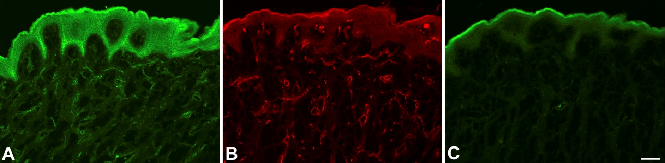
ReliaTech GmbH
Polyclonal antibody against native human soluble VEGFR-2/KDR
(Endogenous sKDR; Cat# 102-PA19S / -PA19)
The polyclonal antibody was generated in rabbits immunized with a peptide of the unique C-terminal end of native human soluble VEGFR-2/KDR (CGRETILDHSAEAVGMP) [Albuquerque et al., Nature Medicine 2009]. Anti-human soluble VEGFR-2/KDR was purified by affinity chromatography with immobilized Protein A.
Consecutive sections of unfixed, human foreskin. A) Staining with anti-sVEGFR2/KDR antibodies (#102-PA19). Note signal in epidermis and vessels. B) Staining with anti-membrane-bound VEGFR-2/KDR (#101-M32). Note staining in vessels. C) Negative control. Note non-specific fluorescence in the hornified layer of the epithelium.
Provided by Prof. J. Wilting, Göttingen, Germany.
http://www.reliatech.de / orders@reliatech.de

